Slide 1

Advanced x86: BIOS and System Management Mode Internals Tools
Xeno Kovah && Corey Kallenberg
LegbaCore, LLC

Slide 2
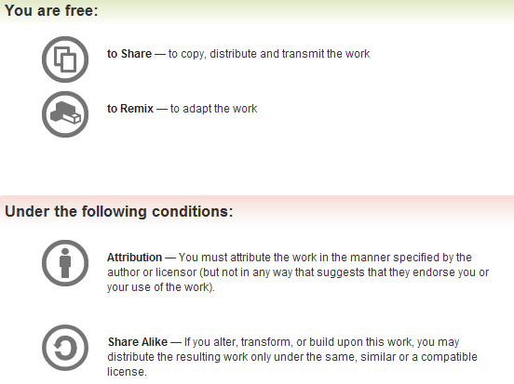
All materials are licensed under a Creative Commons “Share Alike” license.
http://creativecommons.org/licenses/by-sa/3.0/
Attribution condition: You must indicate that derivative work
"Is derived from John Butterworth & Xeno Kovah’s ’Advanced Intel x86: BIOS and SMM’ class posted at http://opensecuritytraining.info/IntroBIOS.html”
Notes:
Attribution condition: You must indicate that derivative work
"Is derived from John Butterworth & Xeno Kovah’s ’Advanced Intel x86: BIOS and SMM’ class posted at http://opensecuritytraining.info/IntroBIOS.html”

Slide 3
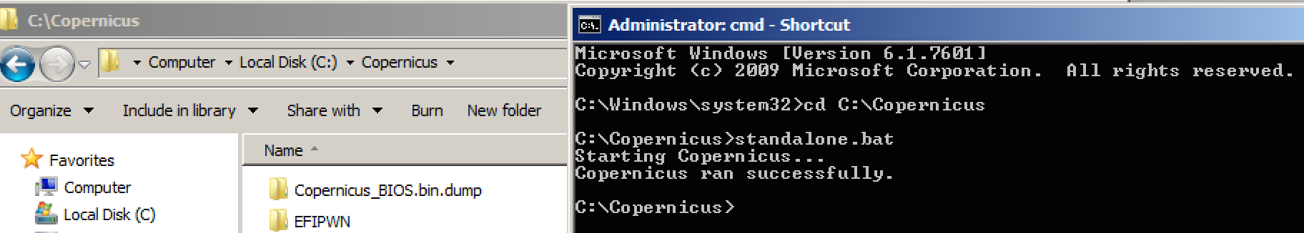
Running Copernicus
Can be downloaded from:
http://www.mitre.org/capabilities/cybersecurity/overview/cybersecurity-blog/copernicus-question-your-assumptions-about
But in this class, use the one in the Tools folder
From admin prompt cd C:\Copernicus and execute standalone.bat

Slide 4
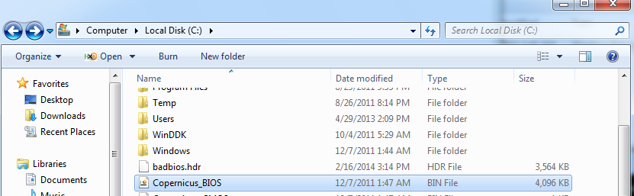
Running Copernicus
Copernicus drops it’s output into the base of the C:\ drive
We’ll talk about a few of these files
The size of this binary will equal the size of your SPI flash
Copernicus dumps all the flash contents (whether readable or not)
For regions which the CPU/BIOS has no permission to read, it writes all 1’s (0xFF)
*Note: badbios.hdr is just the joke-name of the vulnerable BIOS image John created for this class

Slide 5
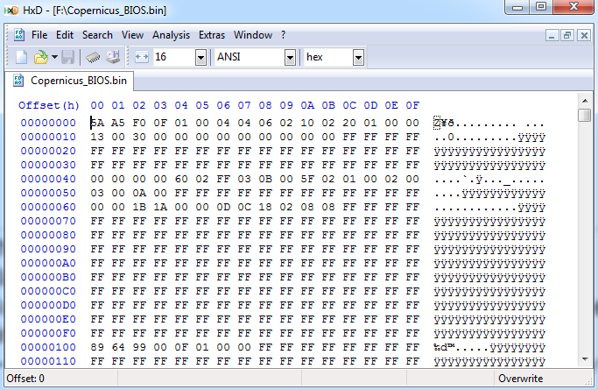
Copernicus_BIOS.bin
This is a dump of the entire flash BIOS
Flash is accessed via the programming registers
Anything Copernicus can’t read (e.g. due to permissions) it just fills in with 0xFFs
Reason: to preserve the flash linear address offsets for each region within the binary

Slide 6
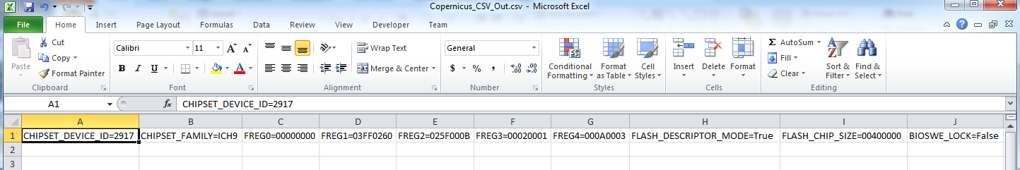
Copernicus_CSV_Out.csv
This is a comma-separated file containing the configuration data that was read from the system
Not all are security-related
what ICH/PCH is present
FREG registers (just to determine the size of each region and the chip)
Many others
Because you are attending this class you can access the full .CSV file measurements
otherwise you are limited only to the most simple SMM/BIOS lock/unlock measurements (but still the most pertinent!)

Slide 7
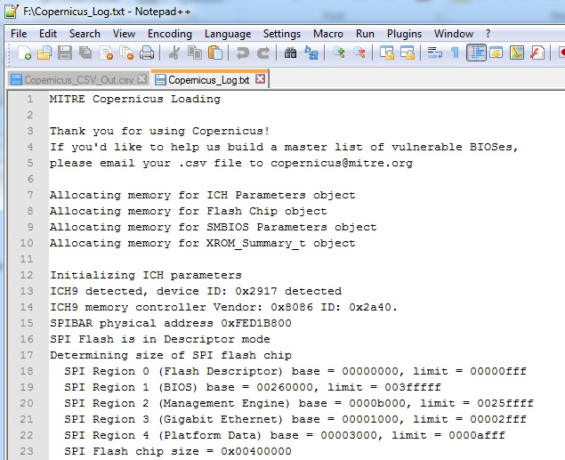
Copernicus_Log.txt
Contains a log file of human-readable information about the system which was just measured
Also exit status to determine which, if any, measurements failed

Slide 8
“see something, say something”
If your output contains:
“Email the following to copernicus@mitre.org so we can look into adding support for this architecture.
Copernicus Error: Unidentified IO Controller Hub vendor=8086, device=9c45
Memory Controller: vendor=8086, device=0a04”
Then email it in so they can add support for the hardware

Slide 9
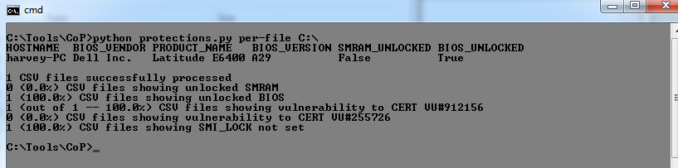
Running Protections.py
Let’s look at the .CSV file in Notepad
By the end of the course you’ll know what these mean
Open a CMD prompt in directory C:\Tools\CoP\
> python protections.py per-version C:\
Can also run per-file, affects the sorting of output
This analyzes our .CSV file for the most basic configuration settings
SMRAM unlocked in the image above is a bug that should be fixed in the version you're using
Anyway, let’s get started on the course!
Notes:
TODO talk to scornwell about this

Slide 10
Some Useful Tools of the Trade

Slide 11
Copernicus
Question your assumptions
Copernicus is a tool we wrote to determine how prevalent vulnerable BIOS’ are “in the wild”
Collects the information we are discussing during this class
BIOS_CNTL, SPI, Chipset settings, etc.
Data can be analyzed offline to determine the vulnerability of BIOS’ in an organization
So far it has been run on nearly 10,000 systems
Runs as a Windows driver (32-bit and 64-bit supported)
Will eventually be released to open source when we have collected enough data to support a whitepaper on our findings
Source code released in a code for data agreement
Data run on many, many systems

Slide 12
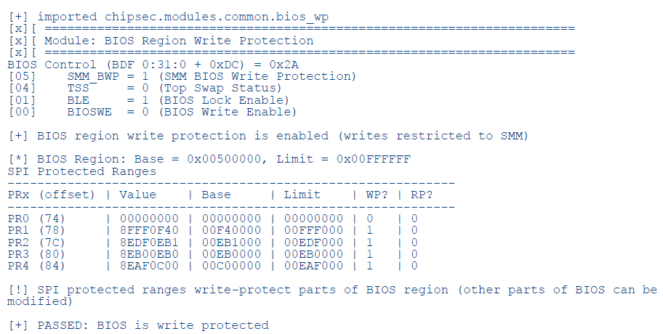
Chipsec
Intel’s open source firmware measurement tool
Yuriy Bulygin and John Loucaidis (Intel) introduced this tool at CanSecWest 2014
https://github.com/chipsec/chipsec
Developers can add new measurement modules to it
Can be run from Windows, Linux, or UEFI Shell

Slide 13
Flashrom
*NIX tool that gives you the ability to read from a variety of SPI flash chips
I’ve only ever used this on Mac (where there’s no Cop/Chipsec support) or as a backup when combined with a BusPirate hardware reader when my DediProg hardware reader didn’t work
I don’t think they ever patched the issue that makes it untrustworthy, even though we called it out specifically and showed the source code in our CanSecWest 2013 presentation

Slide 14
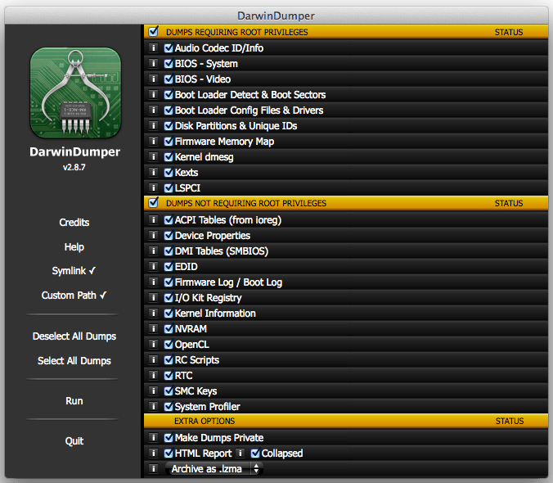
Darwin Dumper
https://bitbucket.org/blackosx/darwindumper/downloads
Finally got around to using this for our Apple vulnerability research work :)
Dumps SPI chip & a bunch of other stuff (also pulls EFI variables off the SPI chip, not through parsing, but through using Apple’s API)
Uses a precompiled flashrom and supporting DirectHW.kext behind the scenes.
DirectHW.kext probably won’t work in the future since Apple recognizes it’s a problem

Slide 15
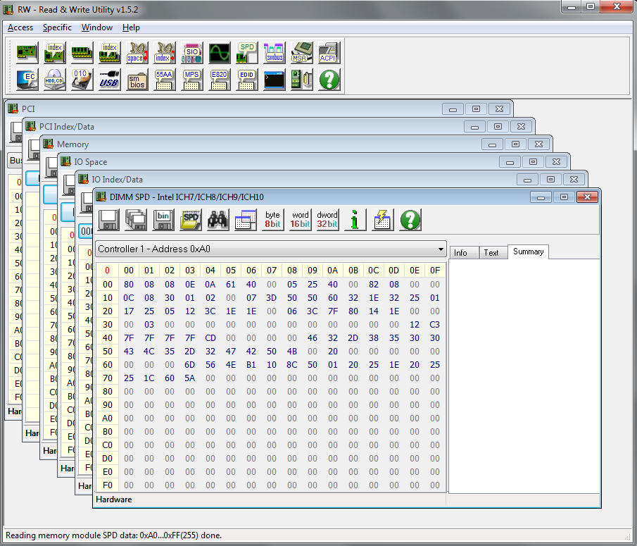
RW Everything (RW-E)
http://rweverything.com/
Powerful utility to observe and/or modify platform hardware configurations
Scriptable so you can test ideas without writing a driver
Access to PCI Config space, IO space, physical memory
Freeware, not open source

Slide 16
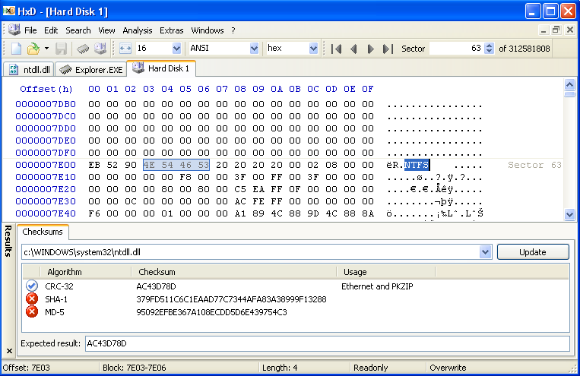
HxD (hex editor for Windows)
http://mh-nexus.de/en/hxd/
Good & solid hex editor for Windows
Some useful features includ file diffing & raw HD access

Slide 17
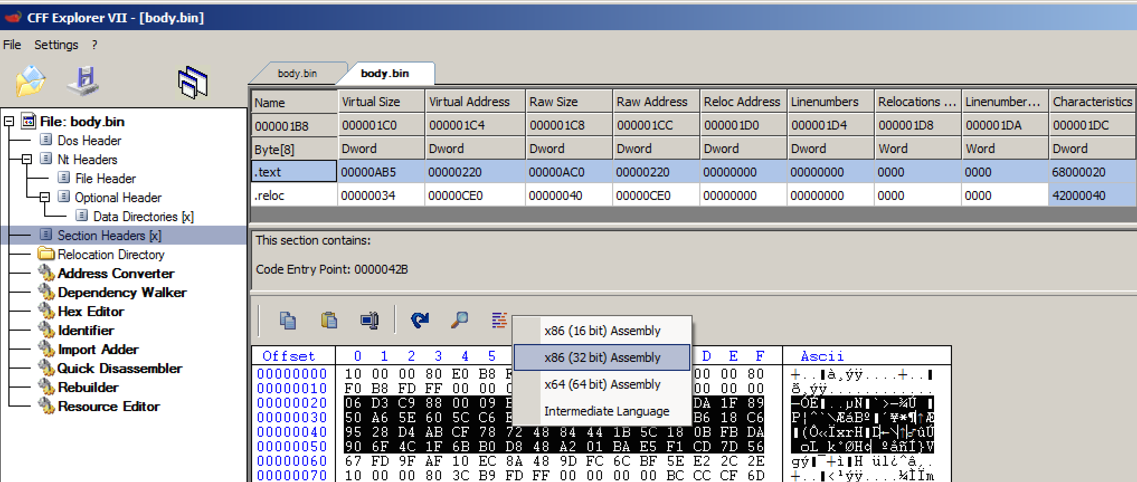
CFF Explorer
http://www.ntcore.com/exsuite.php
For for analyzing PE files (which lots of BIOS files turn out to be).
Has a hex view and a basic 16/32/64 bit disassembler which can be useful for disassembly some arbitrary bytes
Covered more extensively in the Life of Binaries class

Slide 18
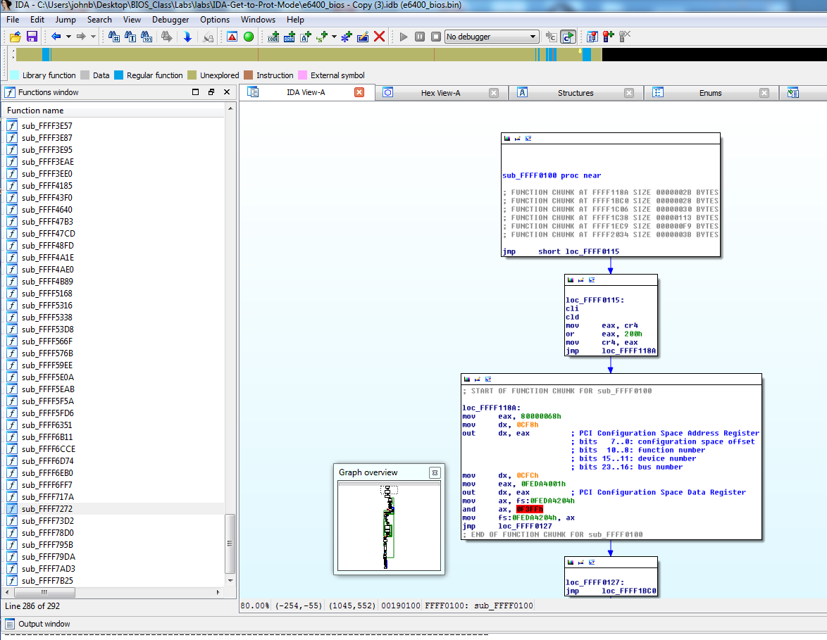
IDA Pro
https://www.hex-rays.com/products/ida/
Free version (5.0) works for this class (minus pseudo-code of course)
https://www.hex-rays.com/products/ida/support/download_freeware.shtml

Slide 19
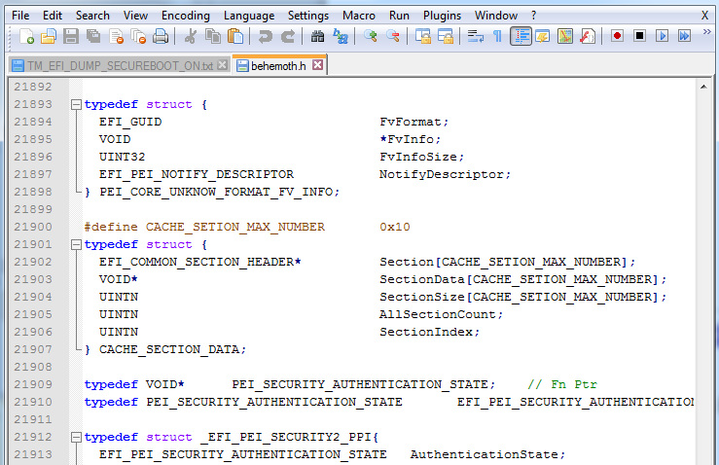
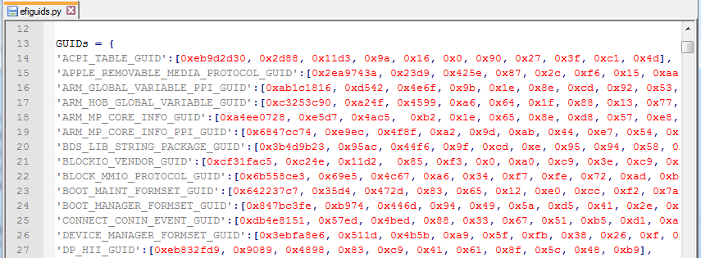
Snare’s ida-efi Utilities
https://github.com/snarez/ida-efiutils
Behemoth.h
UEFI structures to import into IDA Pro, makes code readable
EfiGuids.py
Big list of EFI Guids parsed from various sources
And others, but the above two we use most often

Slide 20
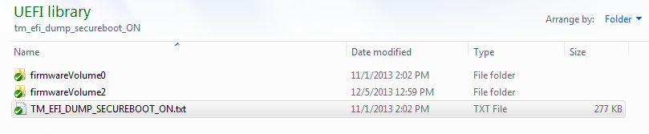
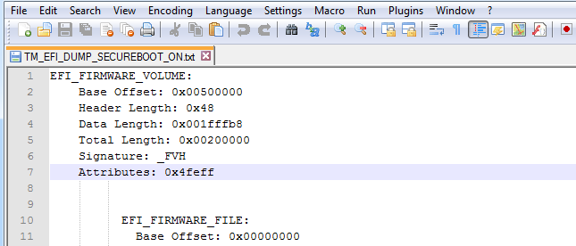
EFIPWN (by G33KatWork)
https://github.com/G33KatWork/EFIPWN
EFI image parser, pulls out .efi modules/drivers
Written in Python, so it can be a bit slow
Prints the PE file structure of an image
Can Dump the PE file contents into a file system structure
This is used behind the scenes for Copernicus’ bios_diff.py. Not necessarily because it’s the best, but because it was the first available when we started the work.

Slide 21
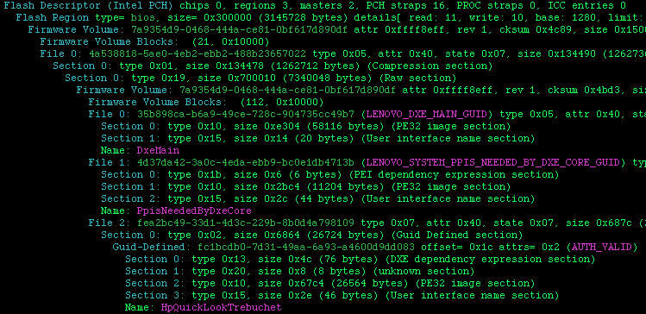
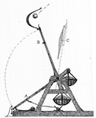
UEFI Firmware Parser (by Teddy Reed)
https://github.com/theopolis/uefi-firmware-parser
Can now also extract some stuff that EFIPWN misses
Prints UEFI non-volatile variables
Automatically identifies the possible usage of a file based on the file GUID
But it can misidentify things which may use the same GUIDs across different vendors (but misidentification is not that big of a deal, since it still gives you a potentially useful name, which is valuable for knowing what it might do, if the file doesn’t have a proper name)

Slide 22
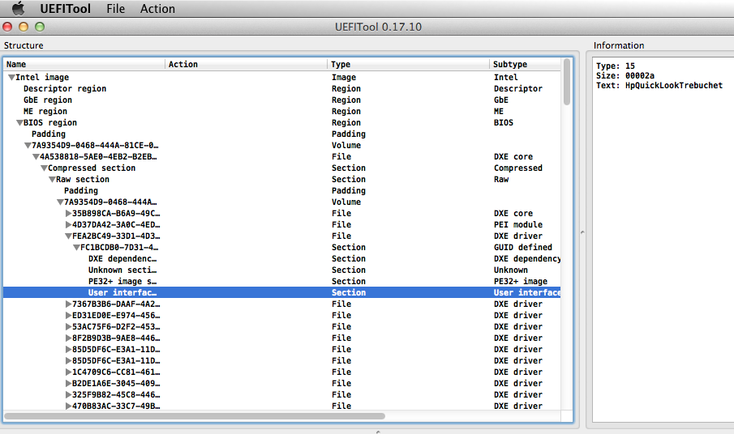
UEFITool (by NikolajSchlej)
Frequently succeeds in extracting files that EFIPWN or UEFI Firmware Parser misses
HP's too cool for a trampoline, they use trebuchets!
https://github.com/LongSoft/UEFITool
Notes:
https://medievalreader.files.wordpress.com/2011/08/trebuchet_copy.jpg

Slide 23
UEFIExtract
Run as “UEFIExtract <bios.bin>”
Will create folder in current directory labeled <bios.bin>.dump
Will then use the same core logic as UEFITool to extract *all* the files at once into their filesystem structure
Good for when you want to search through all files, rather than extract a single target file
Be warned, because of the way it extracts every level of binary at every level of the filesystem, this leads to a massive expansion
E.g. a 12MB BIOS can turn into a 200MB dump

Slide 24
Subzero.io
Ted Reed has created a website that allows you to upload BIOS files, and they will be processed with his UEFI firmware parser
Similar to firmware.re, but PC BIOS specific
Does one thing and does it well
Just in time for BH EUR, he also started parsing Copernicus CSV output with protections.py in order to report whether your BIOS is vulnerable or not
Run “submit.bat”
The site will serve to crowd source what good BIOSes look like, so that we can report when we see something that doesn't look like everyone elses

Slide 25
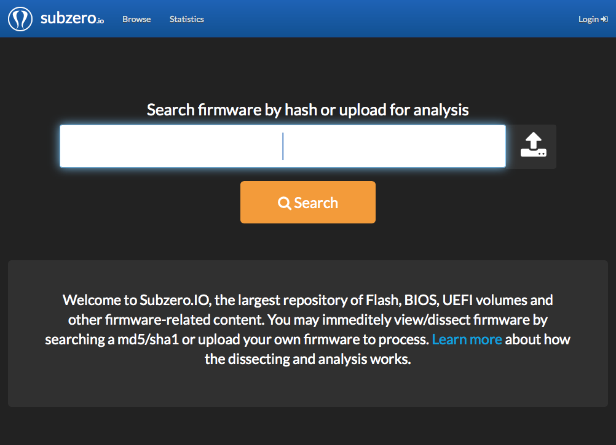

Slide 26
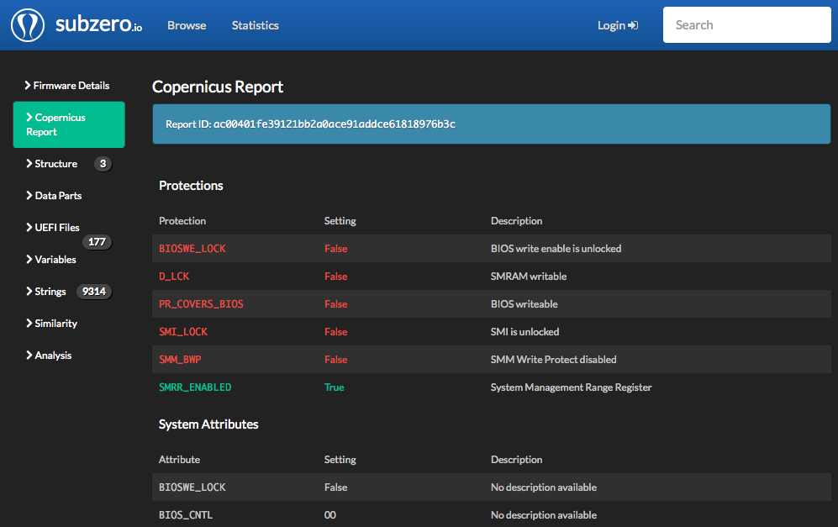

Slide 27
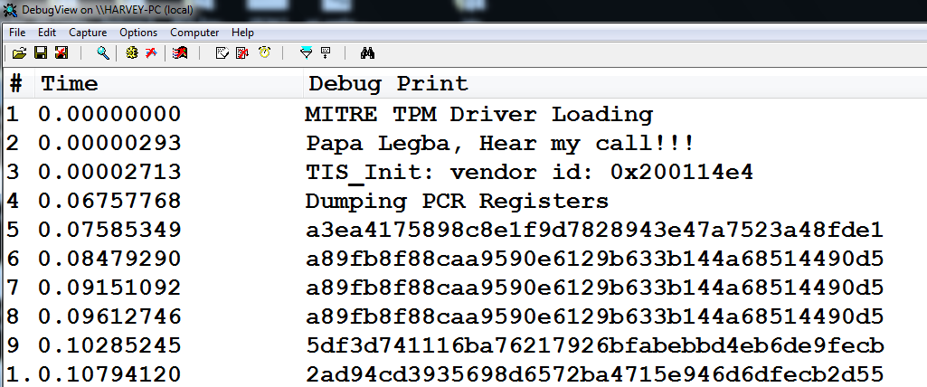
OpenTPM
https://code.google.com/p/opentpm/
Open Source utility written by Corey Kallenberg
Allows you to retrieve quotes of your TPM PCRs (will be covered in Trusted Computing portion of the class)
Linux users can use the tpm_bios and tpm modules to do this

Slide 28
Backup
Tools I haven’t tested

Slide 29
FMEM (Linux)
FMEM is a little known Linux kernel module that provides you access to all physical memory in a system
FMEM creates /dev/fmem
Very useful, since /dev/mem restricts access to various regions
http://hysteria.sk/~niekt0/fmem/
Examples of its use:
Dumps the last 2 MB of system RAM (FFE00000h – FFFFFFFFh)
dd = /dev/fmem of=~/foo.bin bs=1048576 skip=4094 count=2
Therefore, to dump the last 4 MB of memory:
dd = /dev/fmem of=~/bar.bin bs=1048576 skip=4092 count=4
Block size (bs) is 1 MB decimal, you can play with bs, skip, and count to make it less obfuscated (or script it)
So we’re skipping <skip> blocks, then reading <count> blocks

